Slide 1
RISC-V Spring Reseach
Fredick

Slide 2
Section 1.
RISC-V Scalar Core design

Slide 3
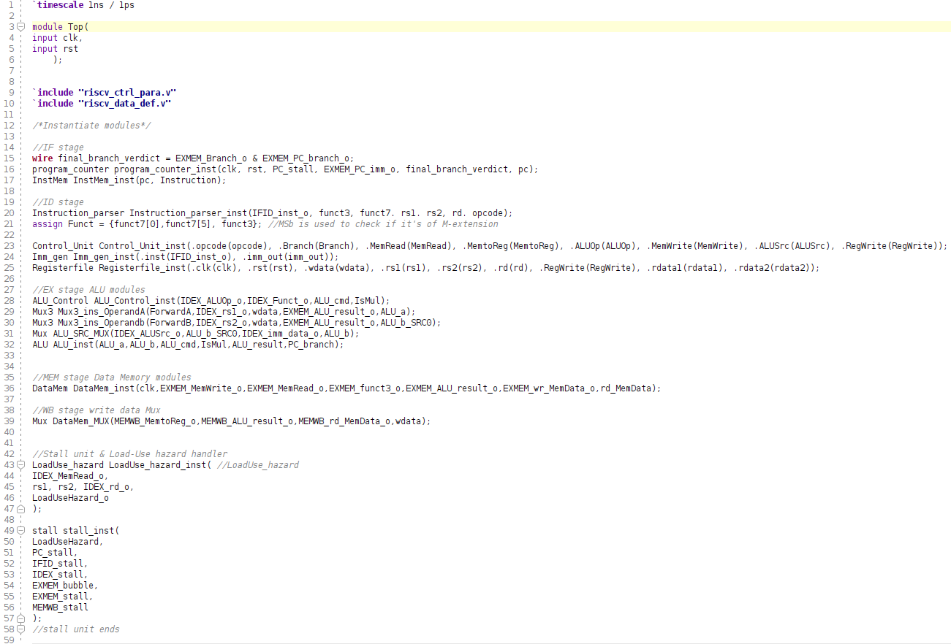
Design hierarchy
Top module:
Program counter
Data memory
Instruction memory
Immediate generator
Register files
Control unit
ALU
ALU control unit
pipeline registers
Stall unit
Forwarding unit
Load-Use hazard handler
branch predictor - not integrated
better multiplier - designing
Cordic - not implemented
Vector extension - designing

Slide 4
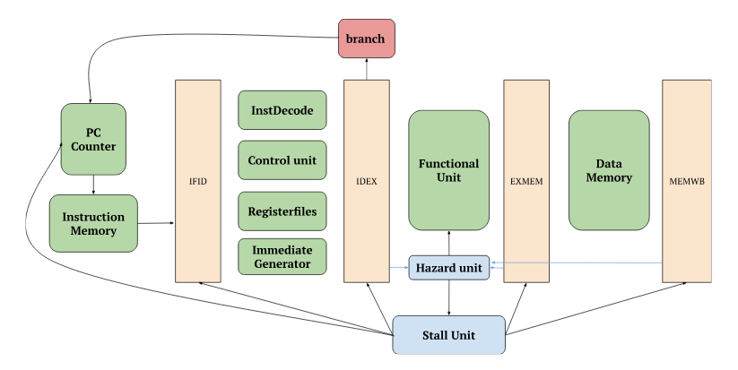
Overview
An overview of the design

Slide 5
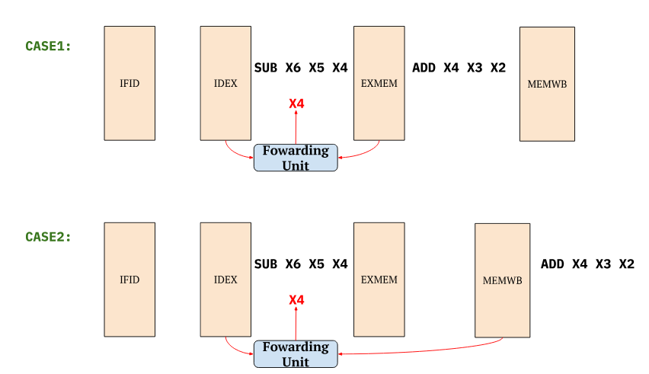
Hazard handling
Hazards handled by forwarding:

Slide 6
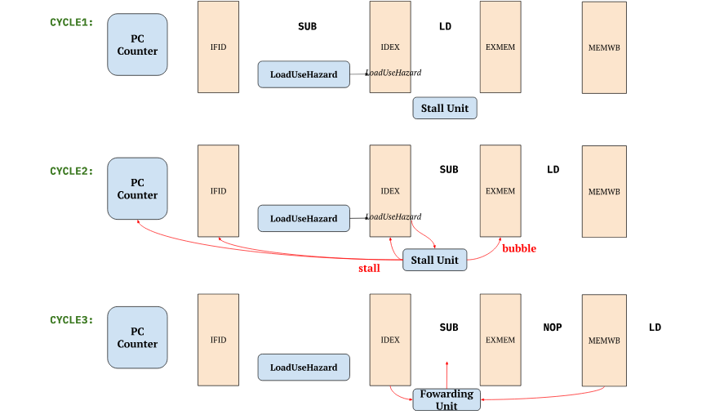
Hazard handling
Load-Use hazard is handled by stalling and bubbling:

Slide 7
Simulation

Slide 8
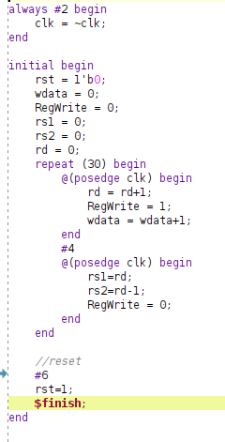
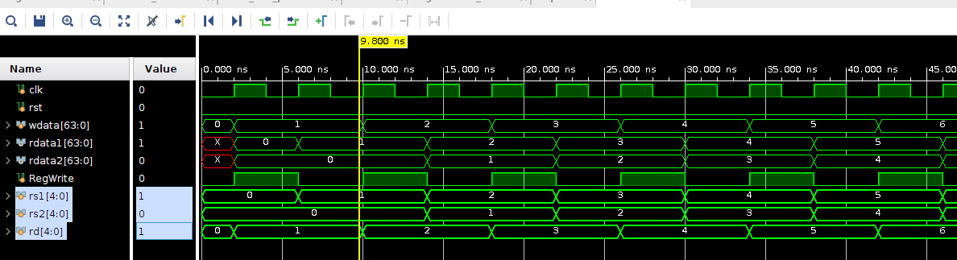
Simulation - Registerfiles
Description:
consecutively feed value into registers from x1~x31
Read out the previously stored registers (rd) and (rd-1) after storing

Slide 9
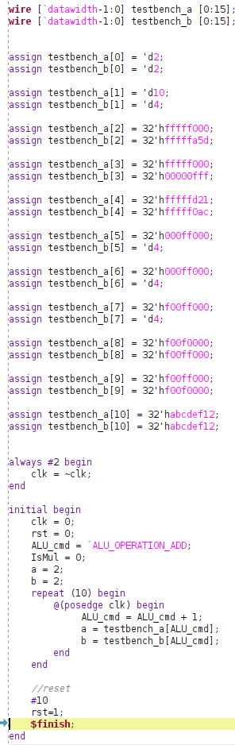
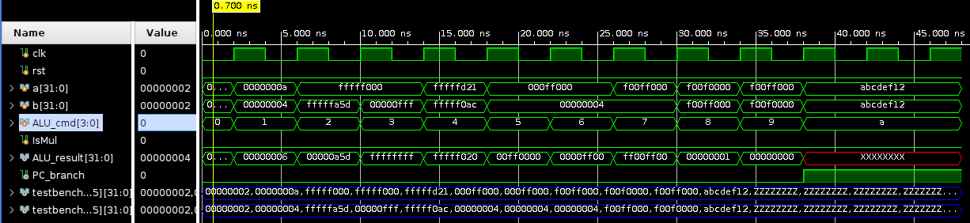
Simulation - Arithmetic Logic Unit
Description:
consecutively perform operations, e.g. ADD, according to the ALU_cmd signals.
When ALU_cmd ≥ 10, the ALU will perform a B-type operation and output a PC_branch flag for PC use.
BEQ for example

Slide 10
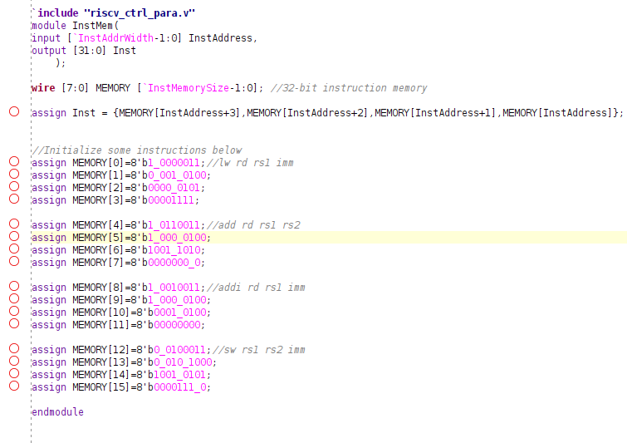
Simulation - Instruction Memory
Description:
Initialize the instruction memory with some values.
read them out consecutively.

Slide 11
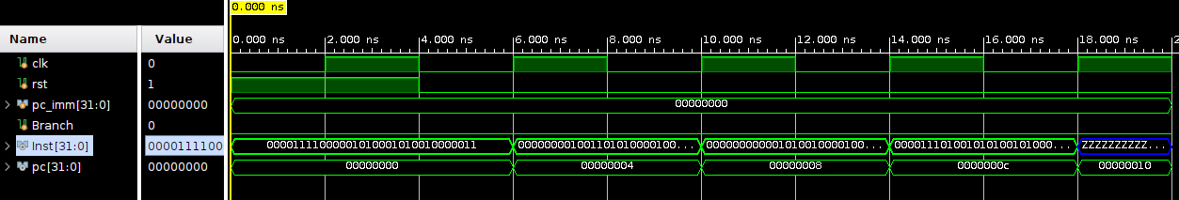
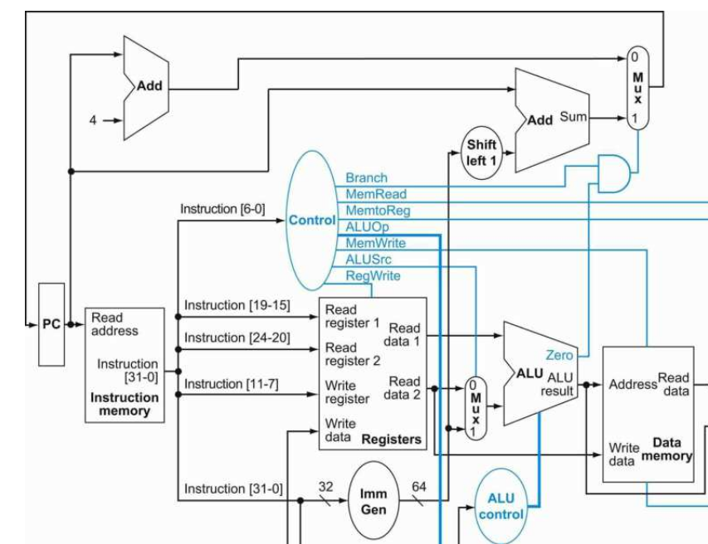
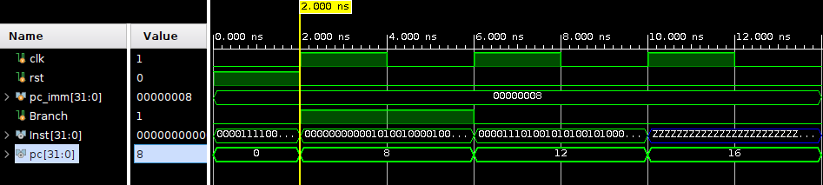
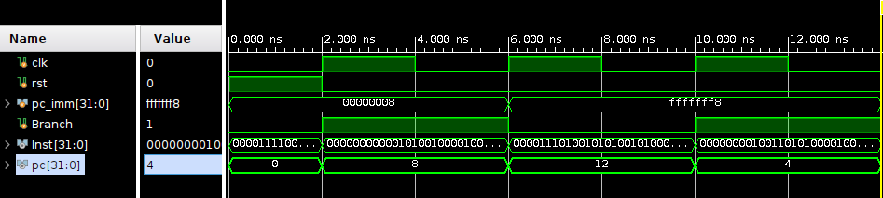
Simulation - PC + Instruction Memory
Description:
Read the instructions through program counter.
Program counter receives branch command and the immediate (+8,-8)

Slide 12
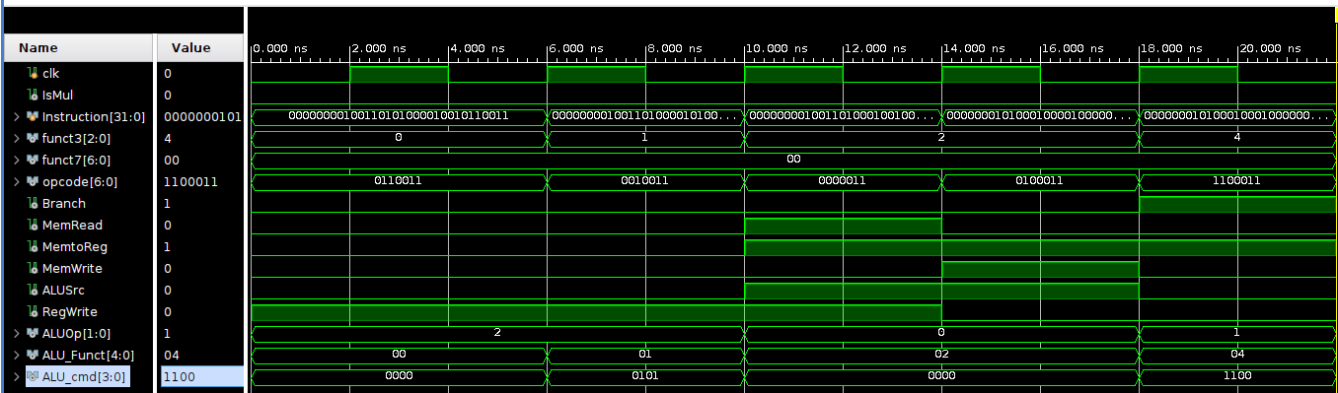
Simulation - Control units
Description:
Connect the central control unit and the ALU control unit together
Observe the ALU control unit's outputs (ALU_cmd)
Control
Unit
ALU
Control
Unit
opcode
ALU_cmd

Slide 13
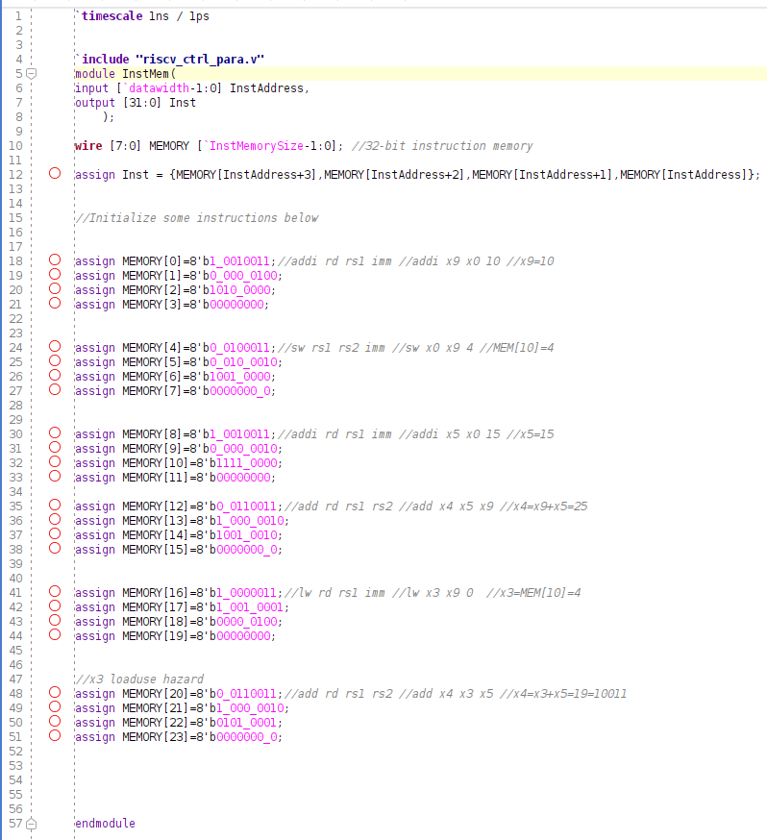
Top module simulation
Initializing the instruction memory:
6 instructions in total
A load-use hazard is designed intentionally

Slide 14
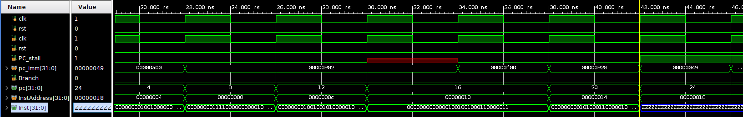
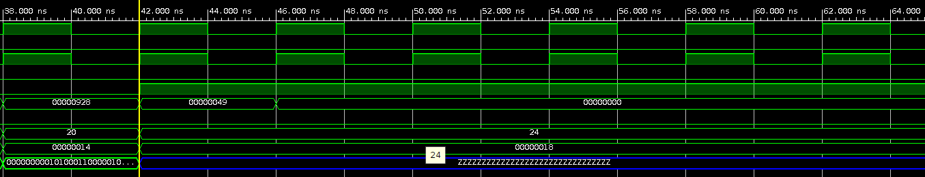
Load-Use hazard
The program counter got stalled because of the load-use hazard:

Slide 15
Section 2
Vector extension zve32 investigation

Slide 16
2.1 RVV introduction

Slide 17
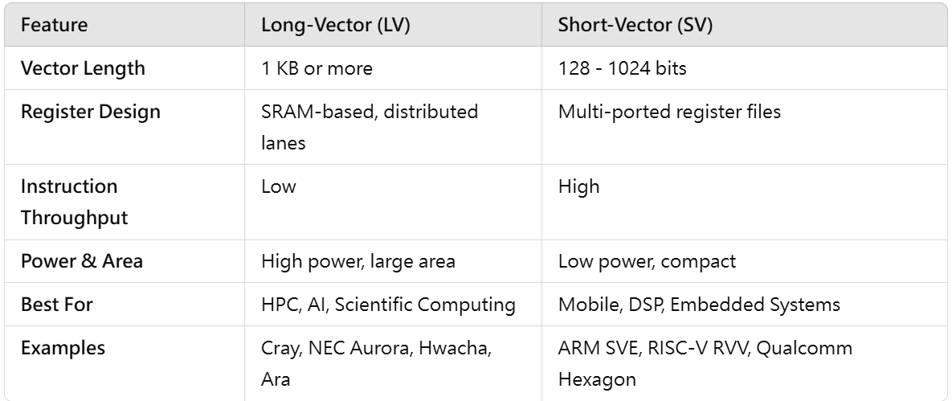

Vector machine background
Vector data-level parallelism speedup
SIMD in time
Amdahl's law - limited speedup
Compiler can vectorize sequential codes
Vector instruction-level parallelism speedup
Use unused lanes or functional units
Traditional long vector architecture v.s. short vector architecture

Slide 18
RVV standard status quo
RVV ratified version 1.0 defined V-extension and other subextensions, along with various instructions and hardware requirement.
Extension Zve* is for embedded system
RVV new draft version defines even more vector subextensions for different applications
RVV is now supported by various compiler tool chain, e.g. LLVM

Slide 19
zve32x
Extension intended for embedded systems which can be added to base ISAs with XLEN=32 or 64:
Minimum VLEN = 32, Supported EEW = 8, 16, 32
main difference from the V extension
All Zve* extensions support
all vector load and store instructions
all vector integer instructions
all vector configuration instructions
all vector fixed-point arithmetic instructions
all vector integer single-width and widening reduction instructions.
all vector mask instructions
all vector permutation instructions (floating-point scalar move instructions)
All Zve* extensions have precise traps

Slide 20
terminology & parameters
VLEN - number of bits in power of 2 in each of the vector registers
ELEN ≤ VLEN ≤ 2^16
ELEN - The maximum size in power of 2 in bits of a vector element that any operation can produce or consume
The maximum width of a lane
ELEN ≥ 8
DLEN - total data path widths in lanes in bits (ELEN × #lanes)
SEW - Selected Element Width (vsew[2:0] = 8 to 64)
width of the currently selected element within the vector register
LMUL: Vector Register Group Multiplier (1/8 to 8)
To group multiple vector registers together and perform operations.
VLMAX: Maximum Operable Elements
maximum number of elements that can be operated on with a single vector instruction given SEW and LMUL
VLMAX = LMUL × VLEN / SEW
Total vector length > VLMAX => Strip mining (software)
VL: Vector Length - vl CSR
An unsigned integer specifying the total number of elements to be updated (operated) with results from a vector instruction
VSTART: Starting Element - vstart CSR
the number (index) of starting element for a particular instruction’s operation within the vector register.

Slide 21
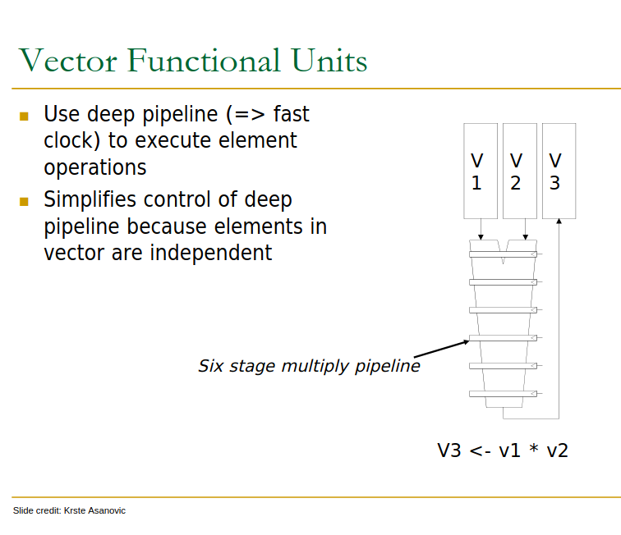
Components
Typical vector machine includes the following units:
Vector data registers
32 registers, each VLEN-bit wide
RVV requires 7 unprivileged CSRs
vstart, vxsat, vxrm, vcsr, vtype, vl, vlenb
Vector functional unit (VFU)
Deep pipelined and execute element operations
Vector Load-Store Units (VLSU)
pipelined to load and store a vector
a lane
[0]
[0]
[0] Onur Mutlu, CMU, https://course.ece.cmu.edu/~ece740/f13/lib/exe/fetch.php%3Fmedia=seth-740-fall13-module5.1-simd-vector-gpu.pdf

Slide 22
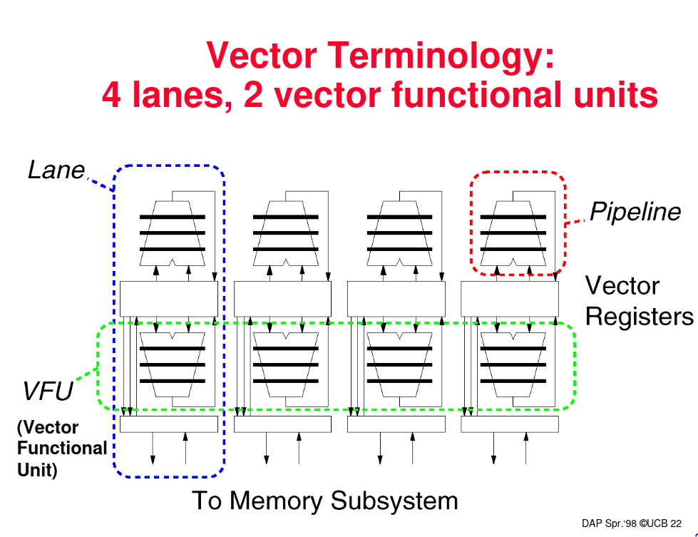
[1]
[1] David A. Patterson, UC Berkeley, https://people.eecs.berkeley.edu/~pattrsn/252S98/Lec06-vector.pdf

Slide 23
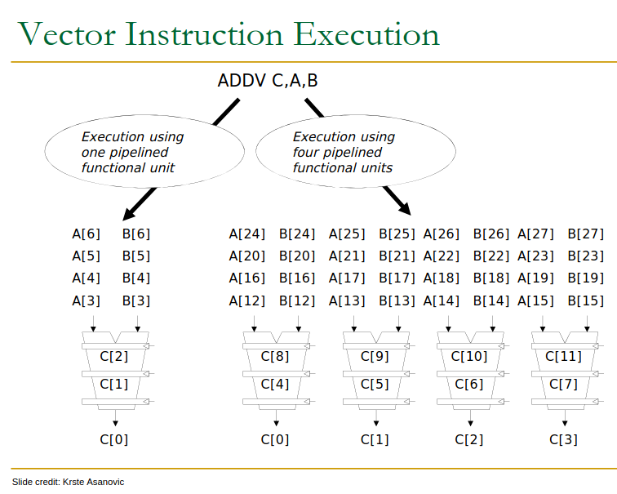
Vector execution
Vector elements operations can be executed in parallel through pipelined VFUs.
element width = ELEN bits
[0]
DLEN bits
[0] Onur Mutlu, CMU, https://course.ece.cmu.edu/~ece740/f13/lib/exe/fetch.php%3Fmedia=seth-740-fall13-module5.1-simd-vector-gpu.pdf

Slide 24
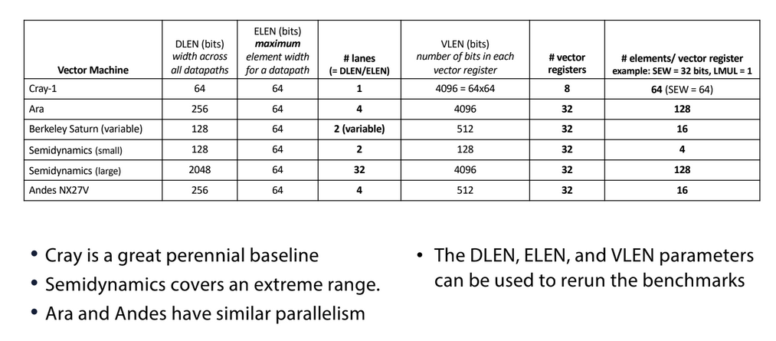
Vector machine examples
[2]
[1] Figure credit: Ray Simar, RVR, Rice University

Slide 25
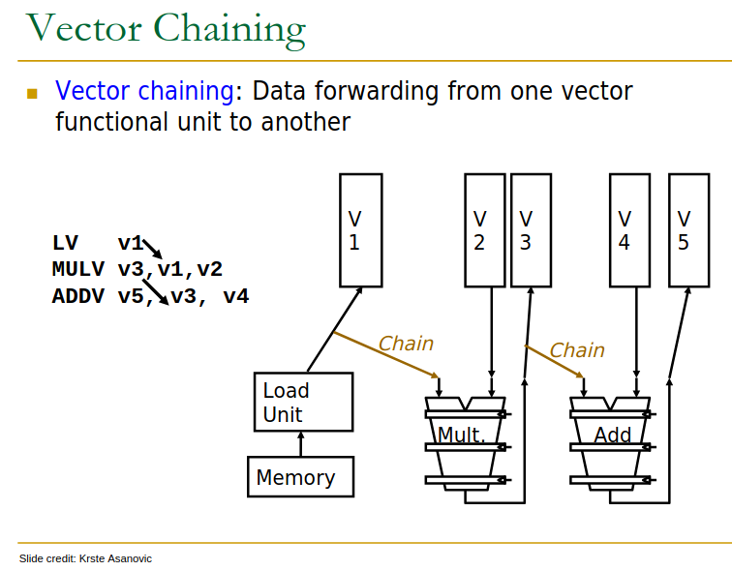
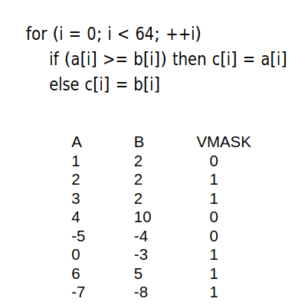
Key features
Pipelining
higher clock rate
Chaining
forwarding data
Vector register grouping
Use vlmul[2:0] grouping register with LMUL
Vector strip mining
Total vector length (AVL) > vlmax e.g. use loop
Use register vl for first iteration, and then VLMAX
what if ELEN > VLEN
RVV now doesn't support this
Scatter/gather operations
when vector data are distributed across memory
combine elements into vector registers
Vector mask instructions
only operates on a portion of elements
[0]
[0]
[0] Onur Mutlu, CMU, https://course.ece.cmu.edu/~ece740/f13/lib/exe/fetch.php%3Fmedia=seth-740-fall13-module5.1-simd-vector-gpu.pdf

Slide 26
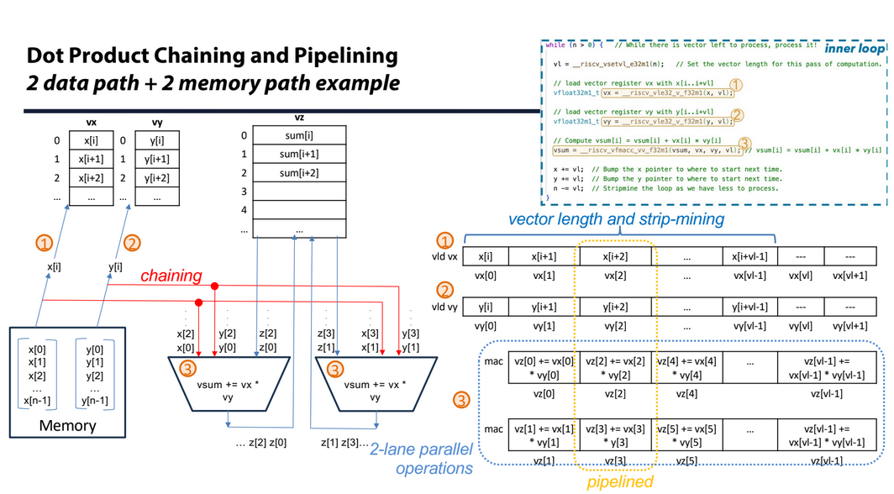
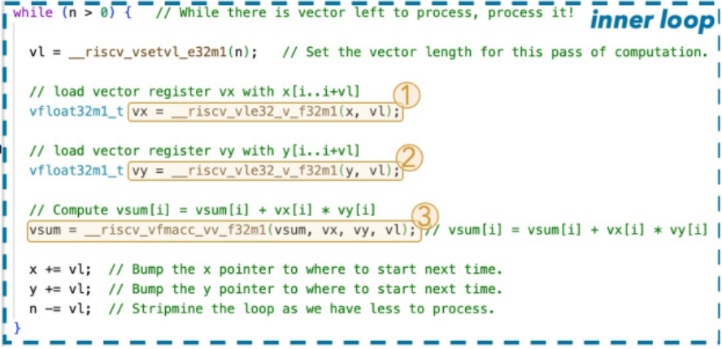
features - a good example
RISC-V intrinsics
MAC operation
x, y might be stored across the memory
compiler knows it
scatter/gather
The way to achieve this is through pipelining
[1] Figure credit: Ray Simar, RVR, Rice University

Slide 27
Vector register grouping
Use vlmul[2:0] to indicate LMUL (assume maximum vector length= 20 elements):
element
19 18 17 16 15 14 13 12 11 10 9 8 7 6 5 4 3 2 1 0
LMUL=1
v1
19 18 17 16 15 14 13 12 11 10 9 8 7 6 5 4 3 2 1 0
LMUL=1/2
v1
19 18 17 16 15 14 13 12 11 10 9 8 7 6 5 4 3 2 1 0
LMUL= 1/4
v1

Slide 28
Vector register grouping
e1
e2
e3
e4
e5
.
.
.
e19
e20
e21
e22
e23
e24
e25
.
.
.
e39
e40
SEW | SEW
SEW | SEW
The maximum number elements per instruction VLMAX = LMUL × VLEN / SEW
e1
e2
e3
.
.
.
e19
e20
SEW | SEW | SEW | SEW
e61
e62
e63
.
.
.
e79
e80
element indices with different LMULs
.
.
.
.
.
.
LMUL = 4
effective VLEN is quadrupled (fixed SEW)
LMUL = 2
effective VLEN is doubled (fixed SEW)

Slide 29
vector masking
Purpose: Masking some elements in an operation
For every instruction, inst[25] decides whether the operated elements are masked
Register v0 determine mask bits for all elements of vectors in the LMUL group
e.g. LMUL=4
VLEN bits (maximum VLEN/SEW elements)
...
sew | sew | sew | sew
v0
G.v4
G.v3
G.v2
G.v1
vector registers' element width

Slide 30
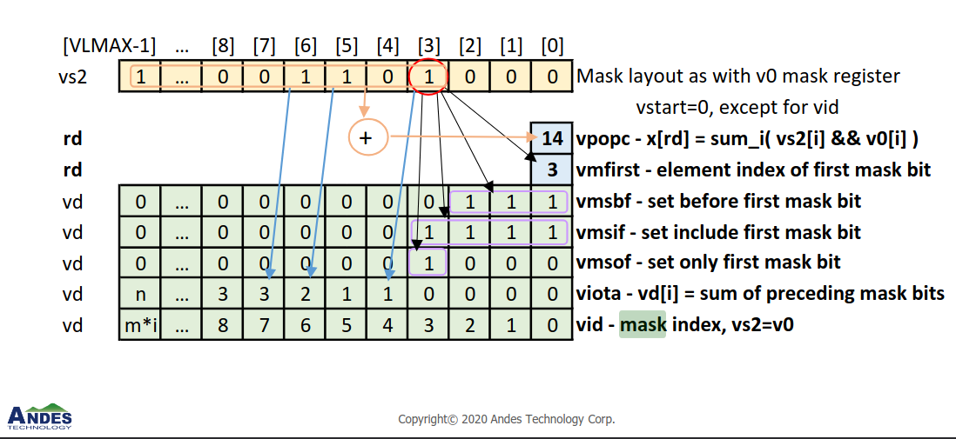
vector mask instructions
The following are a list of vector mask instructions:
Vector Mask-Register Logical Instructions - AND, NAND, AND-NOT, OR, NOR, OR-NOT, XOR, XNOR
only operate on single vector, LMUL is ignored
e.g. vmand.mm vd, vs2, vs1 - vd.mask[i] = vs2.mask[i] && vs1.mask[i]
vpopc - Vector mask population count
vfirst - find-first-set mask bit
vmsbf.m - set-before-first mask bit
vmsif.m - set-including-first mask bit
vmsof.m - set-only-first mask bit
Vector Iota Instruction
Vector Element Index Instruction
[3] Thang Tran, Andes, RISC-V Vector Extension Webinar III, https://www.andestech.com/wp-content/uploads/Andes-RVV-Webinar-III.pdf

Slide 31
Quick summary
VPU = SIMD in time
Parameters
VLEN, DLEN, ELEN determined at design time
LMUL, SEW determined by software, and hence VLMAX
Dedicated hardwares
Vector registers, CSRs, VFU, VLSU, etc.
Features
Chaining
Scatter/gather
vector grouping
VMUL
mask instructions
mask unit

Slide 32
2.2 Vector CSRs

Slide 33
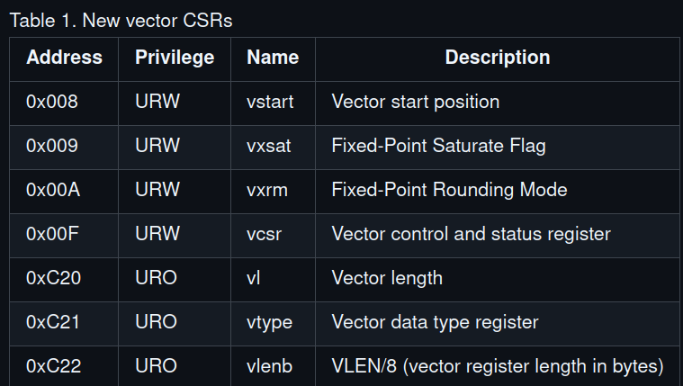
CSRs
URW = Unprivileged Read/Write register
URO = Unprivileged Read-Only
[2] RVV Unprivileged Spec v1.0, https://github.com/riscvarchive/riscv-v-spec/blob/v1.0/v-spec.adoc#sec-inactive-defs

Slide 34
vtype register
31
7 6 5 4 3 2 1 0
...
vill
vma
vta
vsew
vlmul
vlmul[2:0] - LMUL
0, 2, 4, 8, 1/8, 1/4, 1/2
000-111 but 100 reserved
vsew[2:0] - SEW
8, 16, 32, 64
000-011 (The others are reserved for larger value)
vill
If the vill bit is set, then any attempt to execute a vector instruction that depends upon vtype will raise an illegal-instruction exception
Others
reserved or optional

Slide 35
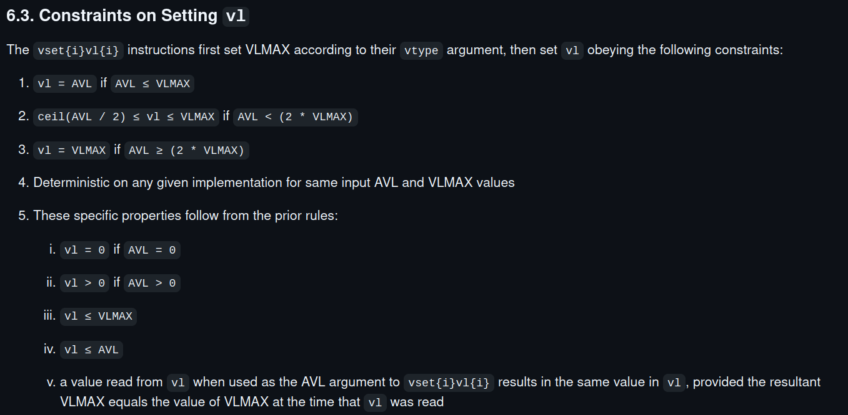
vl register
31
9 8 7 6 5 4 3 2 1 0
...
vl (< VLMAX)
Determines elements per instruction
read-only
but can be updated by CSR instructions
e.g. vsetvli
vlenb register is equivalent but in byte
[2] RVV Unprivileged Spec v1.0, https://github.com/riscvarchive/riscv-v-spec/blob/v1.0/v-spec.adoc#sec-inactive-defs

Slide 36
vstart register
Determine the starting element of a vector register for an instruction:
vstart = 2
 |  | sew | sew | sew | sew | sew | sew | sew | sew | x | x

Slide 37
2.3 RVV instructions

Slide 38
Instruction types
Memory type
e.g. load/store
vmem-format.adoc
Configuration setting type
CSRs
vcfg-format.adoc
Arithmetic type
+-×/
valu-format.adoc

Slide 39
2.3.1 Memory instructions

Slide 40
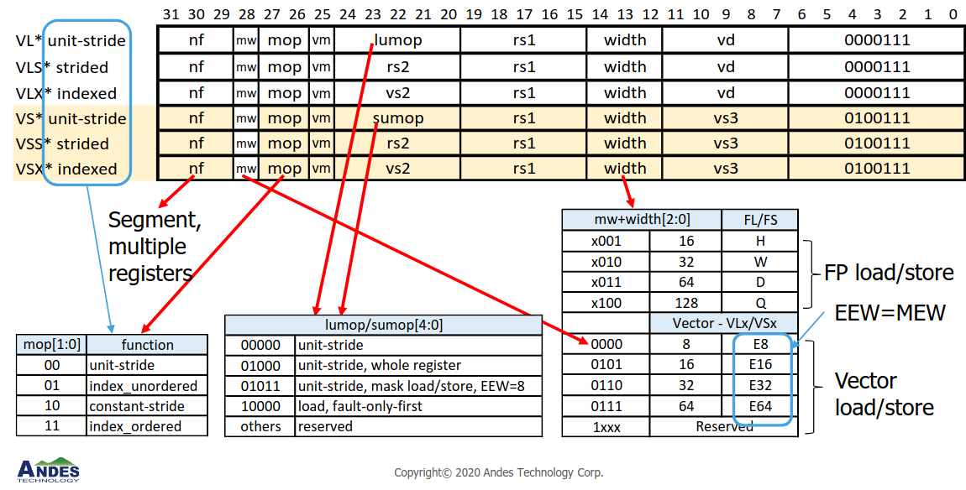
load/store instruction
[3] Thang Tran, Andes, RISC-V Vector Extension Webinar III, https://www.andestech.com/wp-content/uploads/Andes-RVV-Webinar-III.pdf

Slide 41
vector load/store types
Segment Unit Stride Load/Store
load contiguous memory data into a vector register
Segment Stride Load/Store
load memory data by constant distance
stride can be negative or 0 (load the same memory data multiple times)
scatter/gather
Segment index Load/Store
load memory data by random offsets
scatter/gather

Slide 42
Segment Stride load/store
Memory:
1 | 2 | 3 | 4 | 5 | 6 | 7 | 8 | 9 | 10 | 11 | 12 | 13 | 14
settings: NF=3, LMUL=2
vector load
Vector group 3
Vector group 2
Vector group 1

Slide 43
2.3.2
Configuration setting instructions

Slide 44
CSR instructions
The below instructions update vl & vtype by at the same time:
vsetvli rd, rs1, vtypei // rd = new vl, rs1 = AVL, vtypei = new vtype
vsetivli rd, uimm, vtypei // rd = new vl, uimm = AVL, vtypei = new vtype
vsetvl rd, rs1, rs2 // rd = new vl, rs1 = AVL, rs2 = new vtype
=> vl = rd
=> vtype = vtypei or rs2
[2] RVV Unprivileged Spec v1.0, https://github.com/riscvarchive/riscv-v-spec/blob/v1.0/v-spec.adoc#sec-inactive-defs

Slide 45
2.3.3 Arithmetic instructions
integer/fixed point

Slide 46
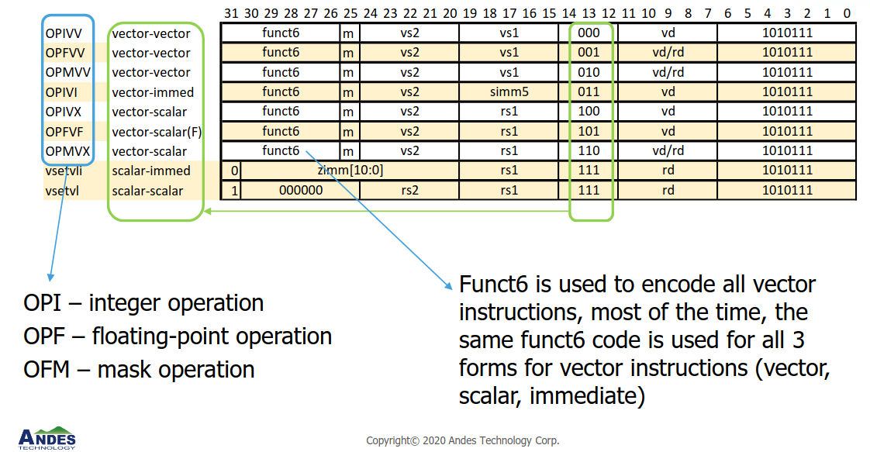
Instruction formats
Note: Arithmetic instruction formats are similar to generic scalar instructions
[3] Thang Tran, Andes, RISC-V Vector Extension Webinar III, https://www.andestech.com/wp-content/uploads/Andes-RVV-Webinar-III.pdf

Slide 47
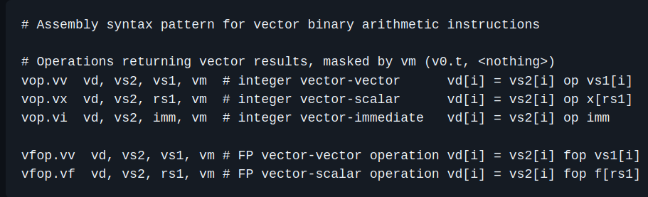
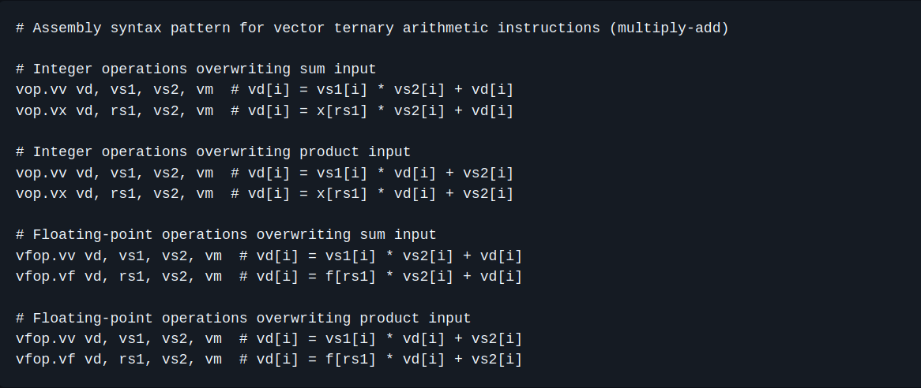
Instruction types
Categorizing instructions in below ways:
Suffix
vv
vector - vector
vx
vector - scalar
vi
vector - imm
Binary v.s. Ternary
Single width v.s. Double-width
Widening, Narrowing
three operands
[2] RVV Unprivileged Spec v1.0, https://github.com/riscvarchive/riscv-v-spec/blob/v1.0/v-spec.adoc#sec-inactive-defs

Slide 48
Integer single-width instructions
Note: Single-width is relative to Double-width, see widening and narrowing instructions
Integer adds
vadd.vv vd, vs2, vs1, vm // vector-vector
vadd.vx vd, vs2, rs1, vm // vector-scalar
vadd.vi vd, vs2, imm, vm // vector-immediate
Integer subtract
vsub.vv vd, vs2, vs1, vm // Vector-vector
vsub.vx vd, vs2, rs1, vm // vector-scalar
Integer reverse subtract
vrsub.vx vd, vs2, rs1, vm // vd[i] = x[rs1] - vs2[i]
vrsub.vi vd, vs2, imm, vm // vd[i] = imm - vs2[i]
Many others

Slide 49
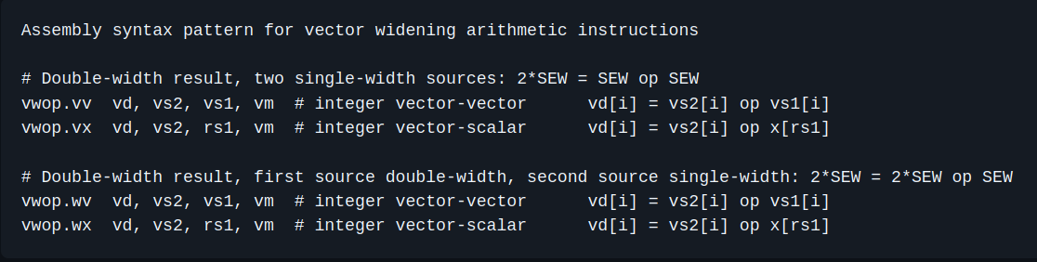
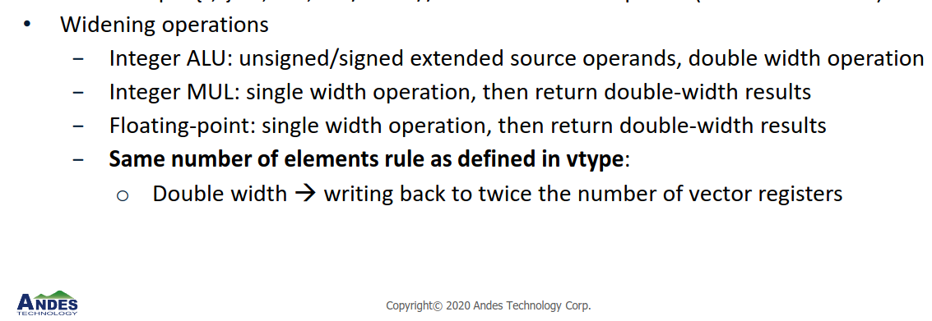
Widening instructions
Purpose: Single-width SEW-wide elements -> Destination registers' elements are 2SEW-bit wide
EEW, EMUL (Effective SEW, LMUL)
In this case, EEW/EMUL=2SEW/2LMUL
Sign/zero extend SEW to 2SEW
before executed
more than cycle
vw* prefix
format: v(f)wop.{v,w}{v,x,f}
w: double-width result
w: double-width operand
[2] RVV Unprivileged Spec v1.0, https://github.com/riscvarchive/riscv-v-spec/blob/v1.0/v-spec.adoc#sec-inactive-defs
[3] Thang Tran, Andes, RISC-V Vector Extension Webinar III, https://www.andestech.com/wp-content/uploads/Andes-RVV-Webinar-III.pdf

Slide 50
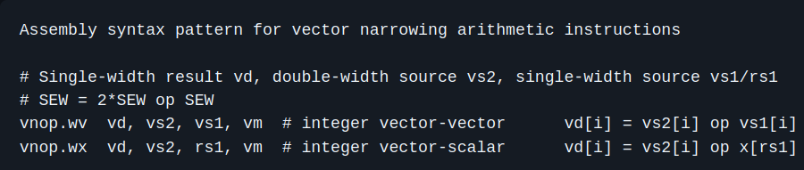
Narrowing instruction
Purpose: Double-width source vectors -> single-width destination vectors.
vector register group specified by vs2 with EEW/EMUL=2SEW/2LMUL -> a vector register group with the current SEW/LMUL setting
vn* prefix
e.g. w in vnsra.wv means double width source register
format: vnop.w{v,x,i} vd, vs2, vs1/rs1
[2] RVV Unprivileged Spec v1.0, https://github.com/riscvarchive/riscv-v-spec/blob/v1.0/v-spec.adoc#sec-inactive-defs

Slide 51
Reduction instructions
Purpose: use a scalar operand (element 0 in vs1) and a vector group (vs2) and reduce all the active elements from vs2 using some binary operators with the scalar operand, to produce a scalar result in element 0 of a vector register vd.
binary operators
&, |, sum, min/max
e.g. calculate norm of a vector by sum reduction
Variable element width
Single width or Widening reduction
LMUL does not affect reduction instructions
 |  |  |  |  |  |  | v11
v1
 |  |  | v25 | v24 | v23 | v22 | v21
v2
sum reduction
 |  |  |  |  |  |  | vd1
vd

Slide 52
Permutate instructions
Purpose: Moving elements from/in a vector to different positions in the same vector or to destination register
Integer Scalar Move Instructions
move elements between vector element 0 and scalar registers
Vector Slide Instructions
Vector Register Gather Instructions
Vector Compress Instruction
Whole Vector Register Move

Slide 53
2.4 RVV software support

Slide 54
Open Source toolchain
There are various toolchains provided for compiling code into vector instructions:
e.g. LLVM/Clang
But compilers are not transparent to users ...

Slide 55
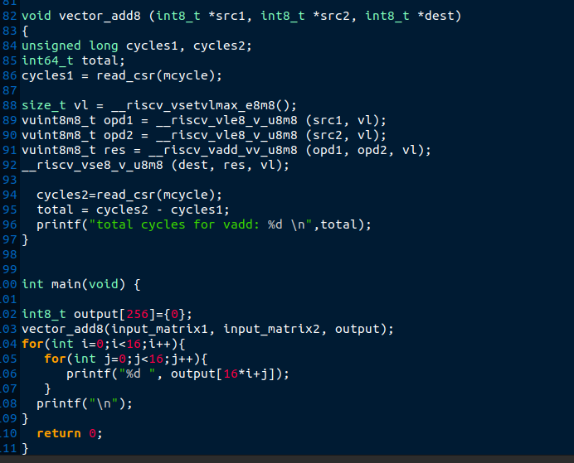
RVV intrinsics
Now, the best way to write and run a code on RVV is through RVV Intrinsics.
SEW=8, LMUL=8
vector unit stride load/store, add
counting the cycles elasped using mcycle CSR
An example RVV intrinsic code

Slide 56
Spike ISA simulator
RISC-V C++ software simulator and a functional model of one or more RISC-V harts.
Good starting point for developing RISC-V software (also RVV)
Very fast compared to RTL simulator like Verilator
lacking cycles information

Slide 57
Section 3
Future goal

Slide 58
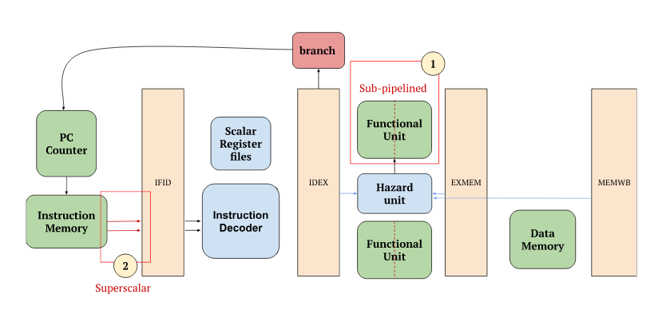
Scalar core design
Priority:
Pipelined EX stage
Single or multi cycle multiplier
Superscalar
Cordic

Slide 59
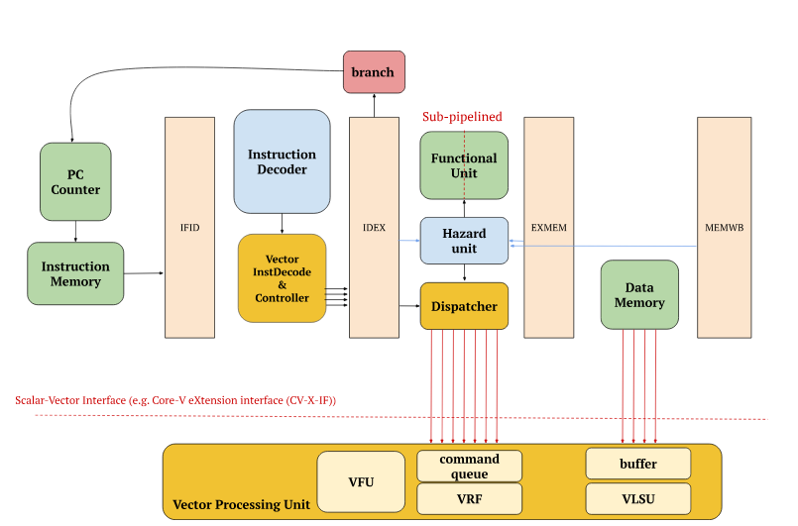
RVV design ideas
Consider using CV-X-IF to avoid modifying the existing design:

Slide 60
Potential design considerations
Different designs may lead to different PPA:
memory & vector registers layout
how does the memory map the bytes?
should they be the same?
memory writing schemes
write-back, write-through (Ara)
data memory contention
between scalar & vector processing unit
Affect PPA

Slide 61
The end

